Slide 1
Re-analysis of PXD006381 Developing mouse lens
Phil Wilmarth PSR Core, OHSU January 2024
Notes:
Mouse lenses are used in a variety of vision research studies and the development of the young mouse lens is an important reference system to characterize. In 2018, Kahn et al. (Khan, S.Y., Ali, M., Kabir, F., Renuse, S., Na, C.H., Talbot, C.C., Hackett, S.F. and Riazuddin, S.A., 2018. Proteome profiling of developing murine lens through mass spectrometry. Investigative Ophthalmology & Visual Science, 59(1), pp.100-107.) published a deep proteome profiling of the developing mouse lens. The data is publicly available from the Proteomics Identification Database (PRIDE) with project number PXD006381. A thorough re-analysis of the data is presented here as a resource for the lens research community.

Slide 2
Study overview
Mouse lenses at 6 stages: E15, E18, P0, P3, P6, and P9
Several mice lenses pooled at each age to get enough protein
Each set of ages repeated 3 times (biological-like replicates)
Tandem mass tag (TMT) labeling, Thermo Lumos, SPS-MS3
TMT kit channel numbers (at that time) required 3 plexes (for each age set)
6 ages per TMT plex, 3 plexes, 24-fractions each
Deep proteome obtained
There were no common standard channels for combining plexes
Study design was balanced per plex

Slide 3
Re-analysis overview
Public data downloaded from PXD006381 (72 RAW files)
Re-analyzed with Comet/PAW pipeline
Mouse canonical FASTA file
Wide tolerance Comet search (variable M+16, static C+57, static TMT labels)
Peak heights for reporter ions
Protein intensity sums of “unique” PSM reporter ion intensities
Average protein intensity per plex used for mock reference channel
IRS method used to combine the 3 balanced plexes

Slide 4
Data set re-analysis summary stats
Data | Acquired MS2 Scans | Identified MS2 Scans (1% FDR) | ID Rate (%) | Protein IDs | Ave. Total Plex Intensity
Set 1 | 532,682 | 119,745 | 22.5 | 5,167 | 14.0 billion
Set 2 | 468,149 | 84,109 | 18.0 | 4,627 | 13.1 billion
Set 3 | 485,261 | 74,436 | 15.3 | 3,916 | 7.6 billion
Totals | 1,486,092 | 278,290 | 18.7 | 5,753
Observations:
Set 1 worked best (more PSM IDs, more protein IDs)
Set 2 had big drop in PSMs and proteins but less drop in intensity
Set 3 was not so good (fewer PSMs and proteins, big drop in intensity)

Slide 5
Comparison of re-analysis to paper
Analysis | Identified PSMs | Proteins Set1 | Proteins Set2 | Proteins Set3 | Total Protein IDs
Publication | 207,459 | 4,630 | 4,426 | 3,747 | 5,404
PAW re-analysis | 278,290 | 5,167 | 4,627 | 3,916 | 5,753
PAW gain (%) | 34.1 % | 11.6 % | 4.5 % | 4.5 % | 6.5 %
Observations:
Proteome Discoverer and 10 ppm precursor mass tolerance less effective
Many additional PSMs map to higher abundance proteins and protein IDs grow more slowly than PSM IDs
Paper used an incomplete Swiss-Prot mouse FASTA file (17K sequences)

Slide 6
How to combine the three plexes?
The replicates for each developmental age are in different plexes
TMT plexes have batch-like effect from pseudo-random MS2 sampling
Data between plexes cannot be directly compared
Two alternatives for comparing data between plexes
Compute abundance ratios to one developmental age
6 ages become 5 ratios and there is information loss
Batch correct intensities between plexes
IRS method already established for multi-plex TMT studies
Average protein intensities per plex can be used as reference channel proxies in balanced study designs

Slide 7
What is internal reference scaling (IRS)?
See https://pwilmart.github.io/TMT_analysis_examples/IRS_validation.html
Each protein’s intensity is a collection of randomly sampled peptide intensities
The random sampling is different in each TMT experiment (a plex)
Proteins at identical abundances between plexes won’t have identical intensities
Common standard channels in each plex (or plex averages in balanced studies) are used to compute protein corrections to remove random sampling effect
Internal standards (or averages) will be identical after IRS
Samples between plexes can be directly compared after IRS

Slide 8
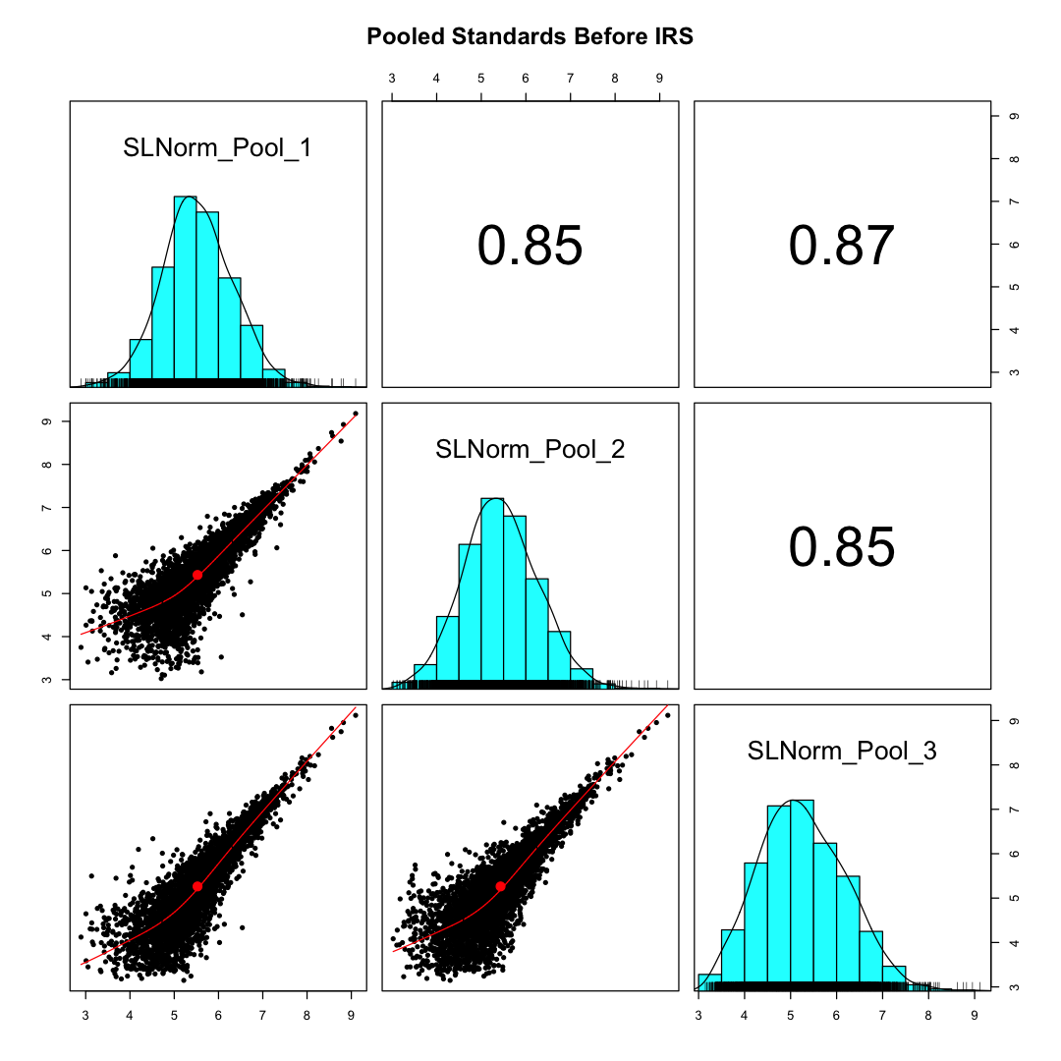
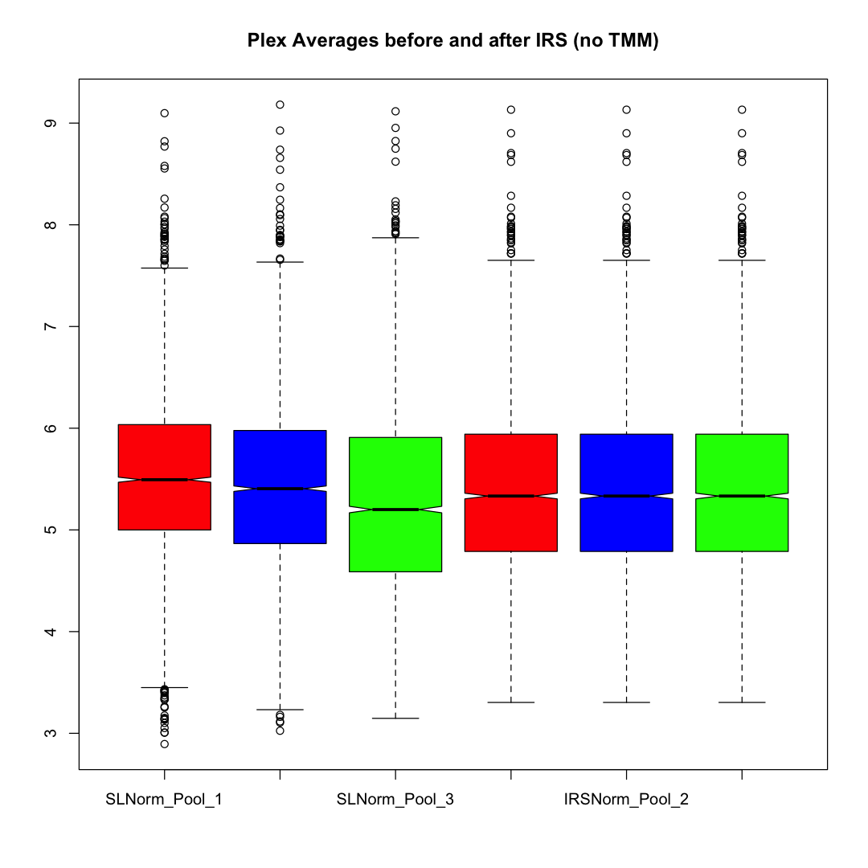
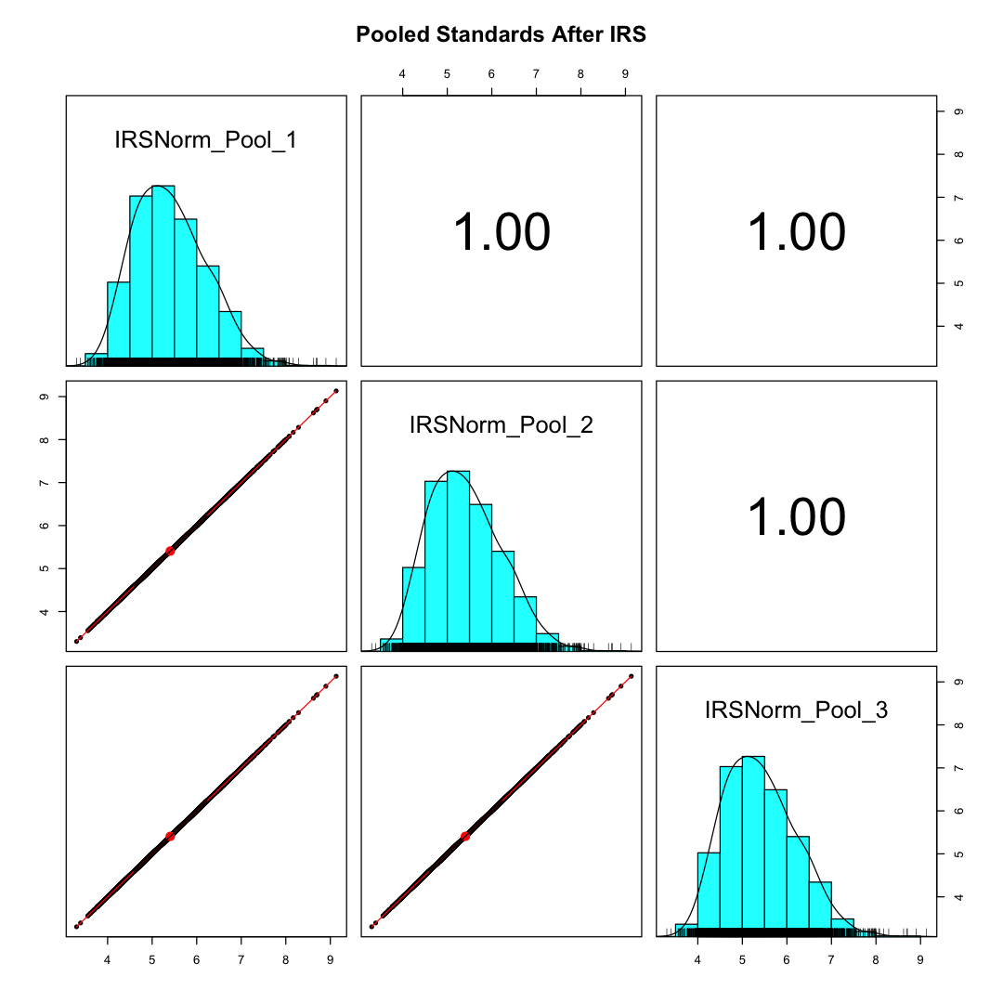
Plex averages before and after IRS
Random sampling is a major source of variation in TMT experiments
3 boxplots on left are before IRS. The third plex (green) had reduced intensity.
IRS mathematically makes the standard channels identical

Slide 9
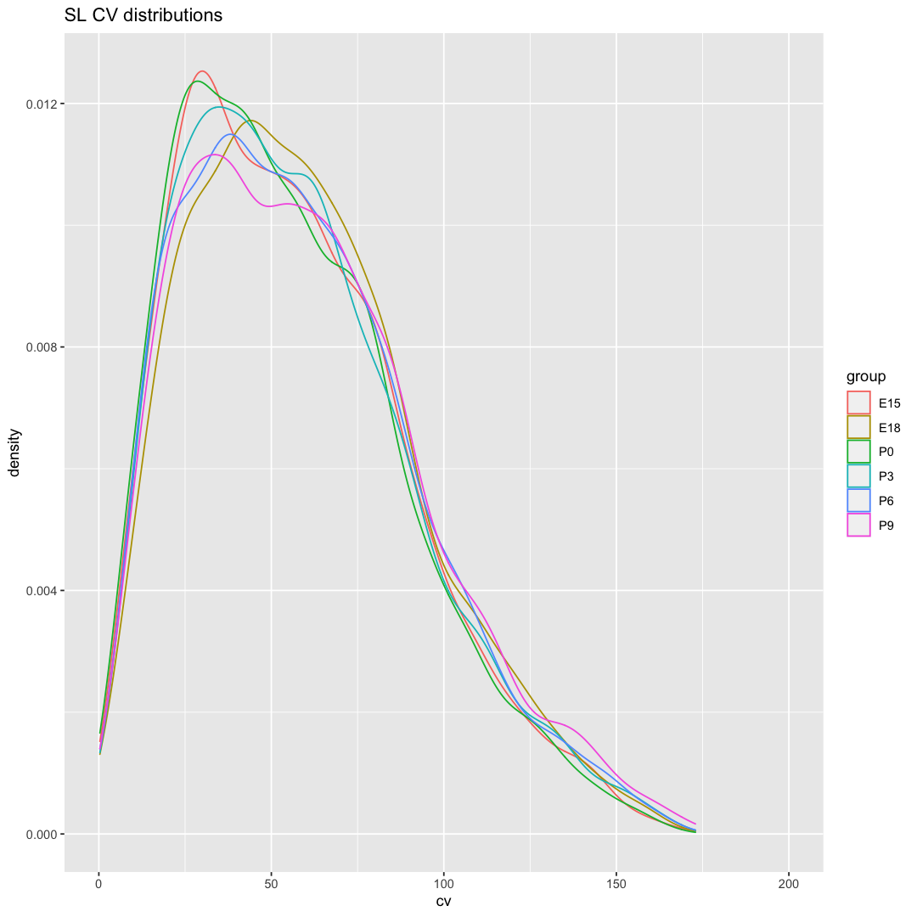
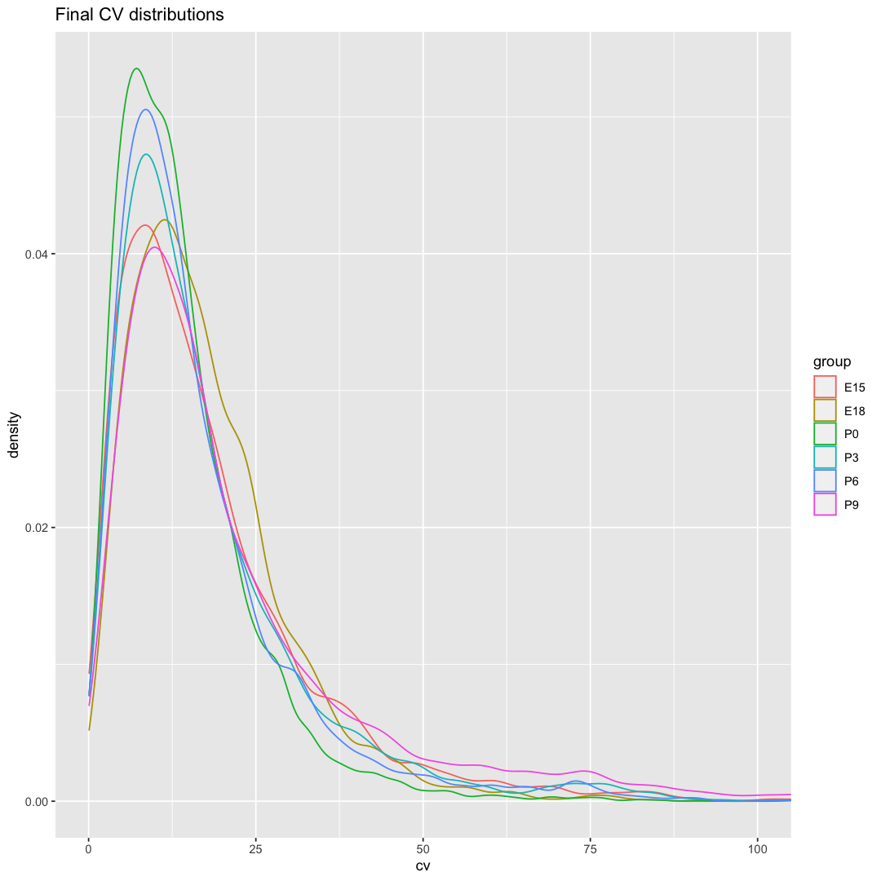
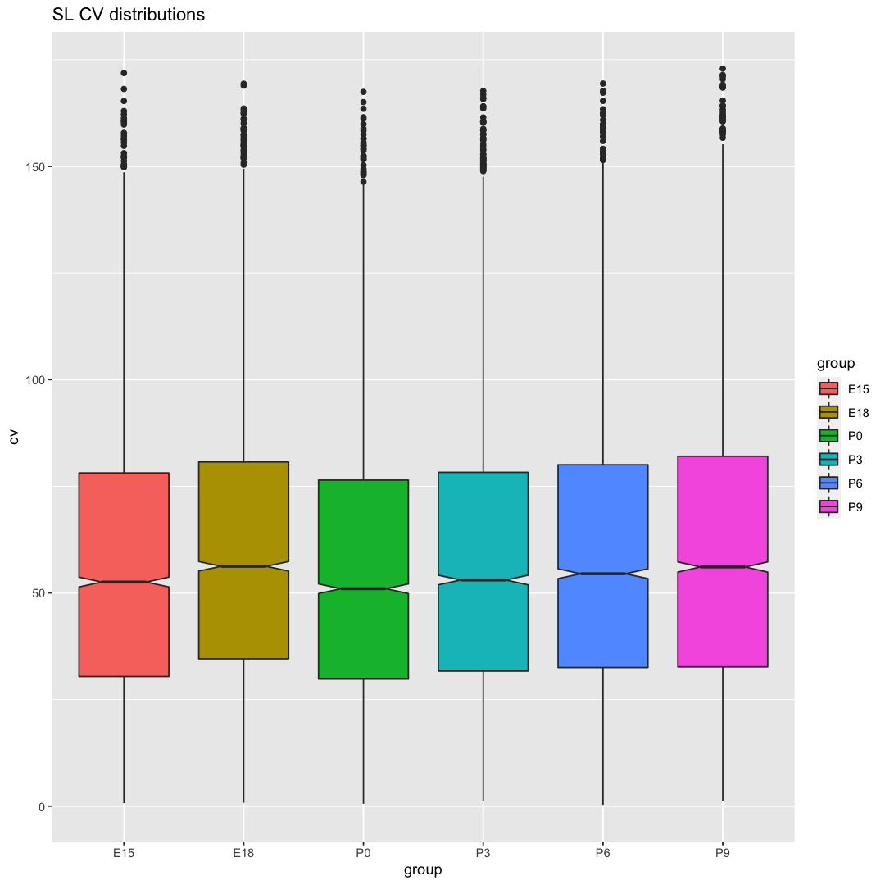
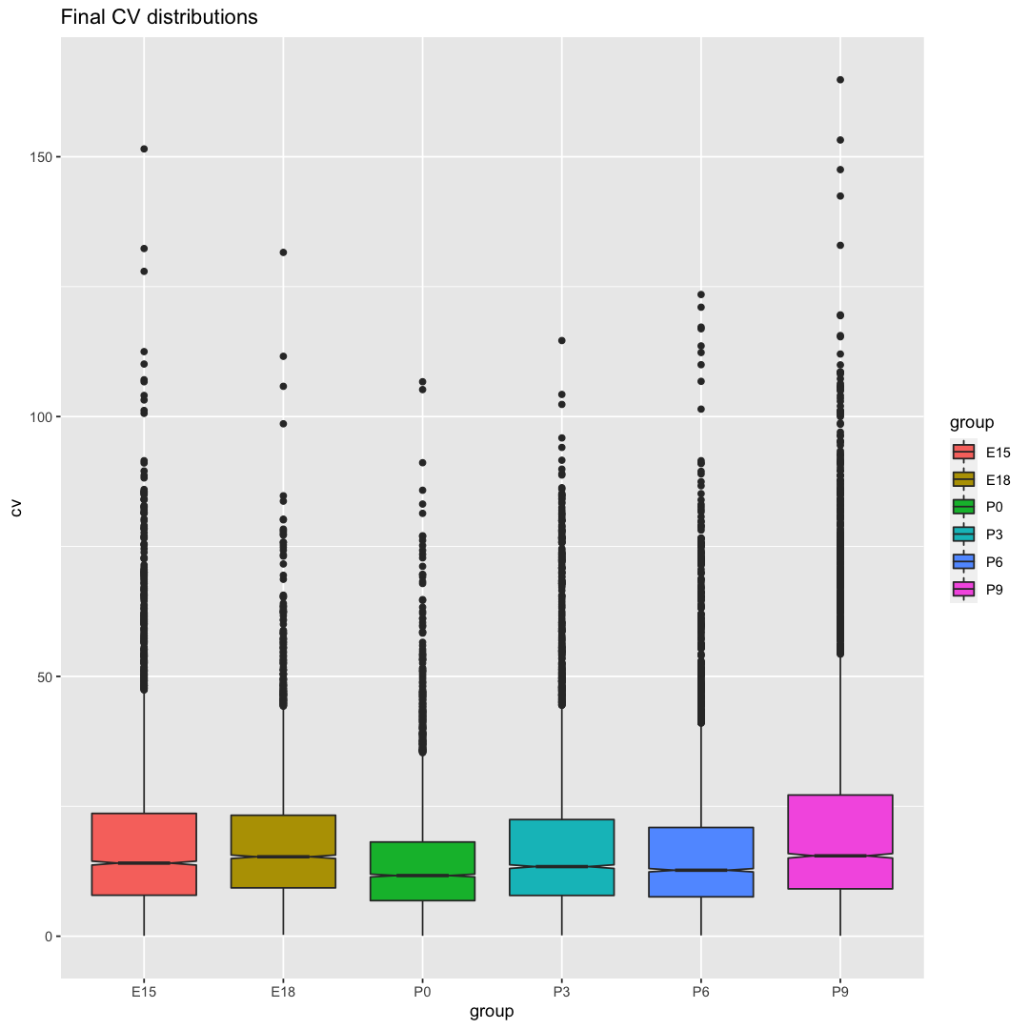
IRS dramatically reduces variance
Ave. median CV 13.8%
Ave. median CV 53.9%

Slide 10
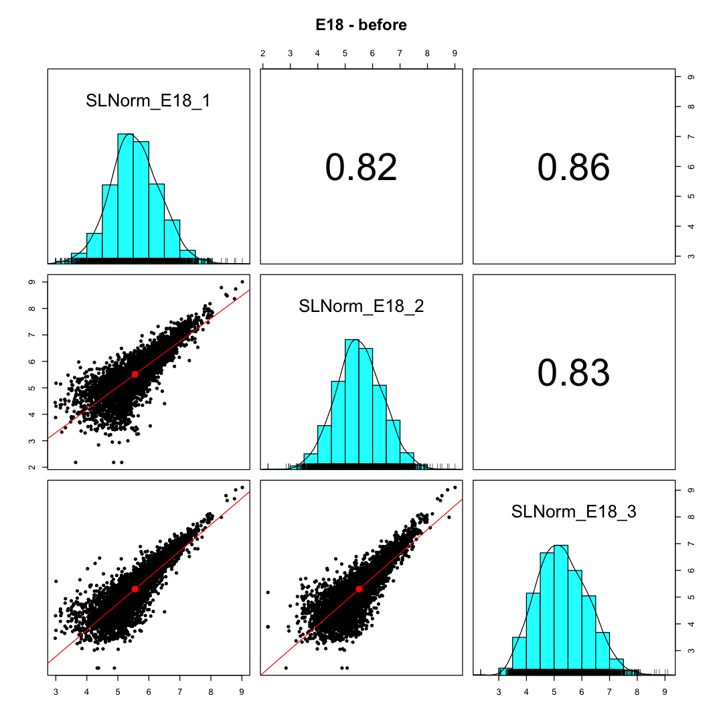
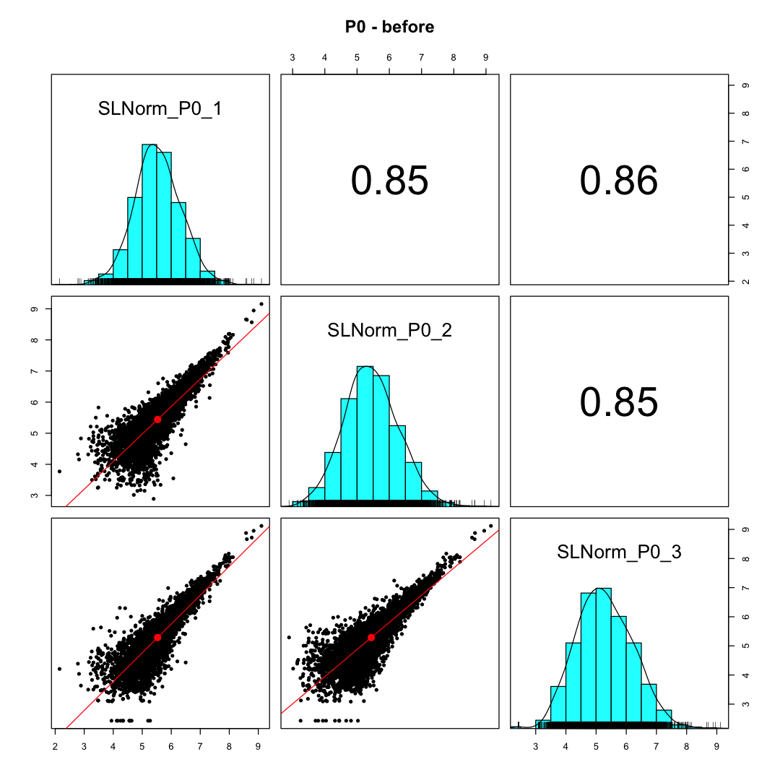
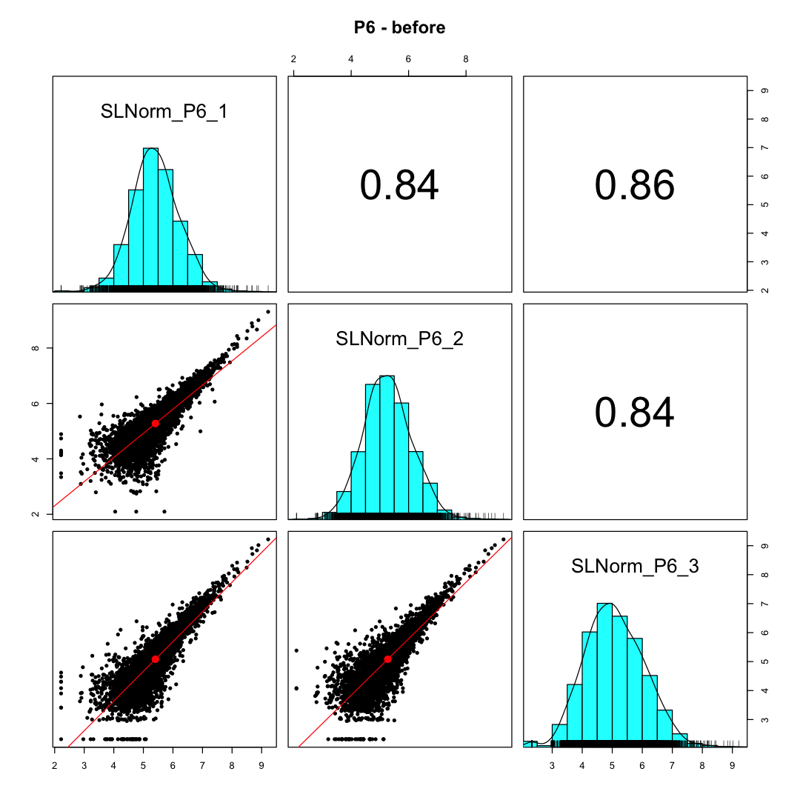
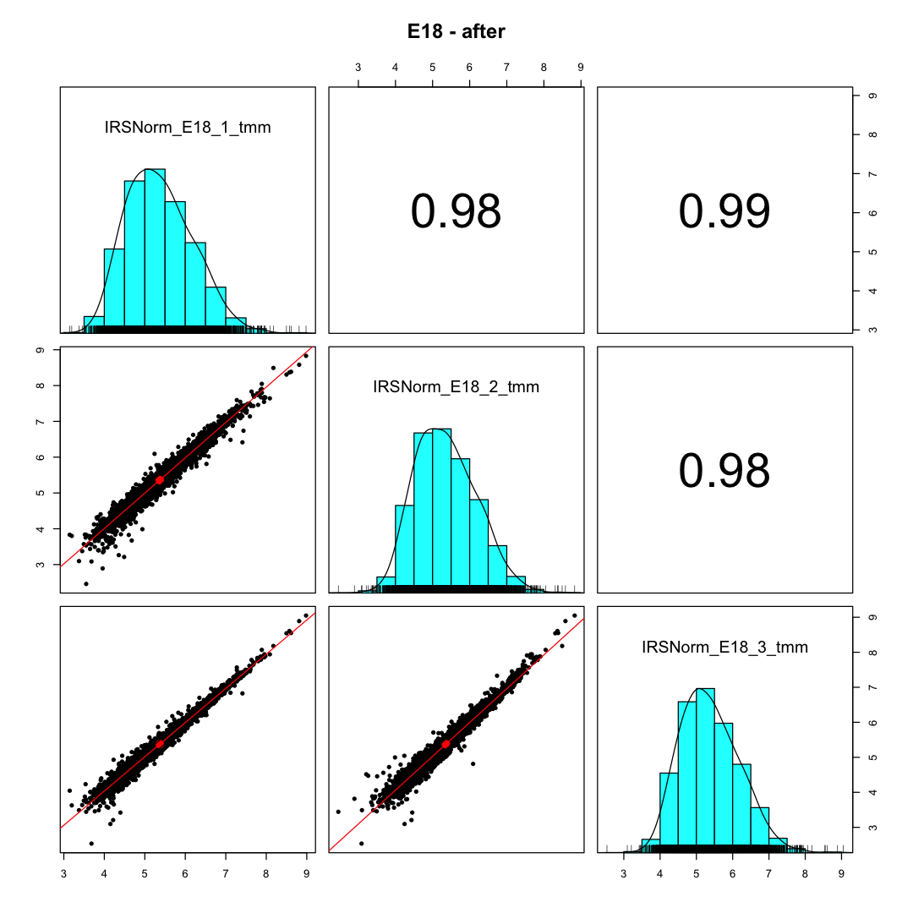
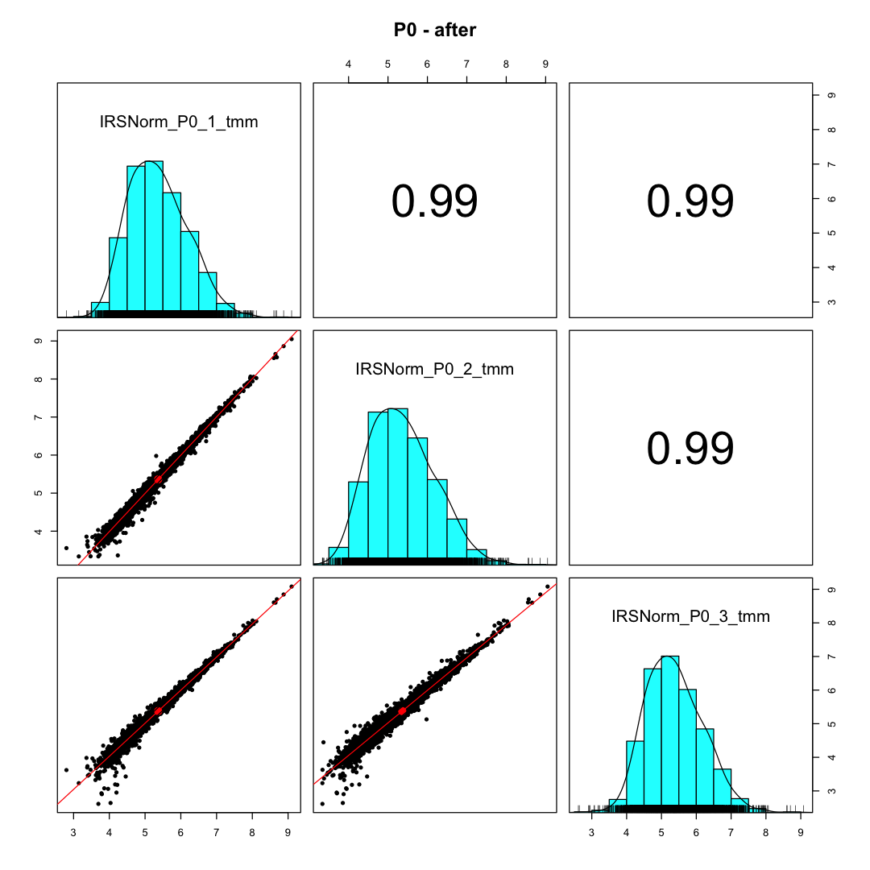
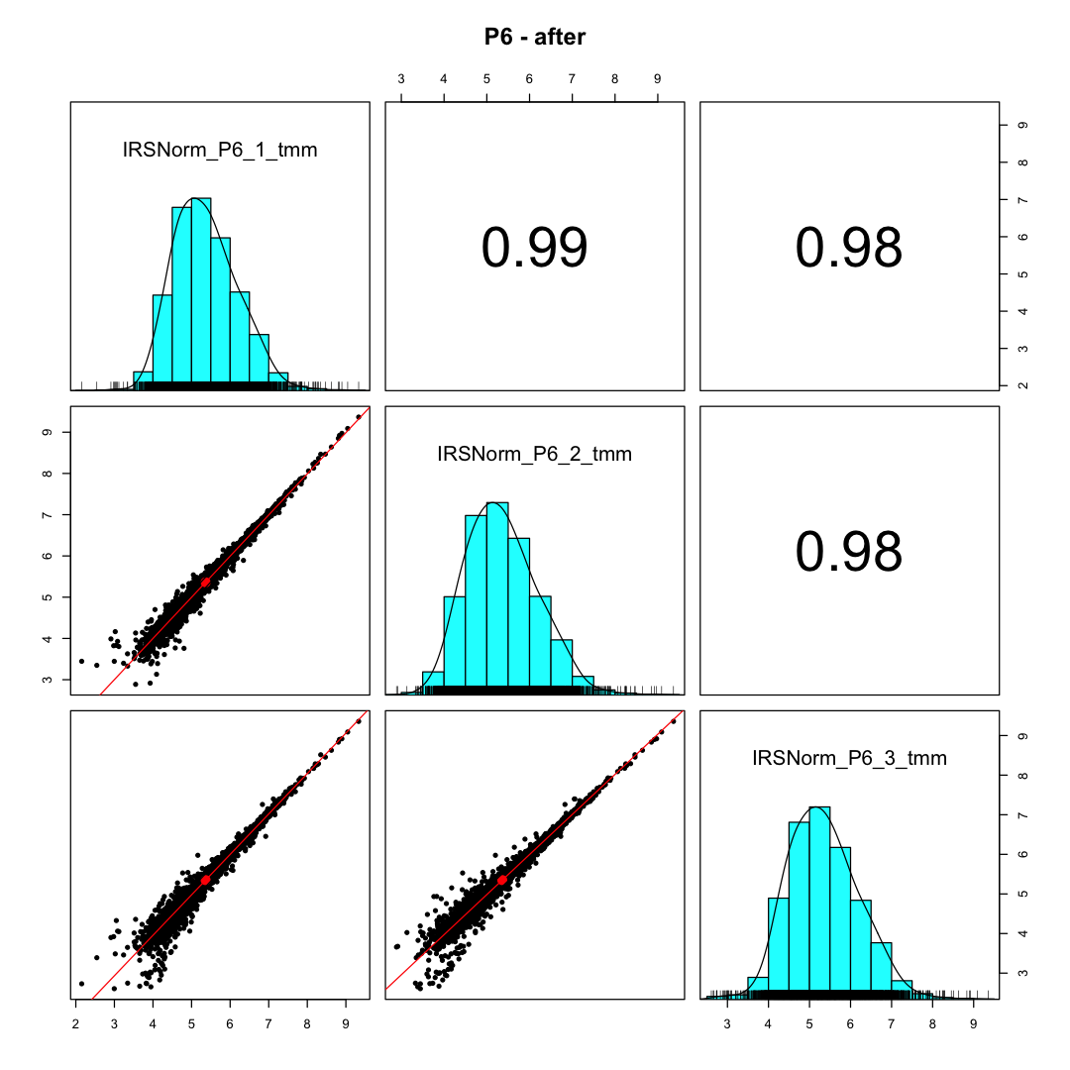
Biological replicate within-group variability
Before IRS
Before IRS
Before IRS
E18
P0
P6
After IRS
After IRS
After IRS

Slide 11
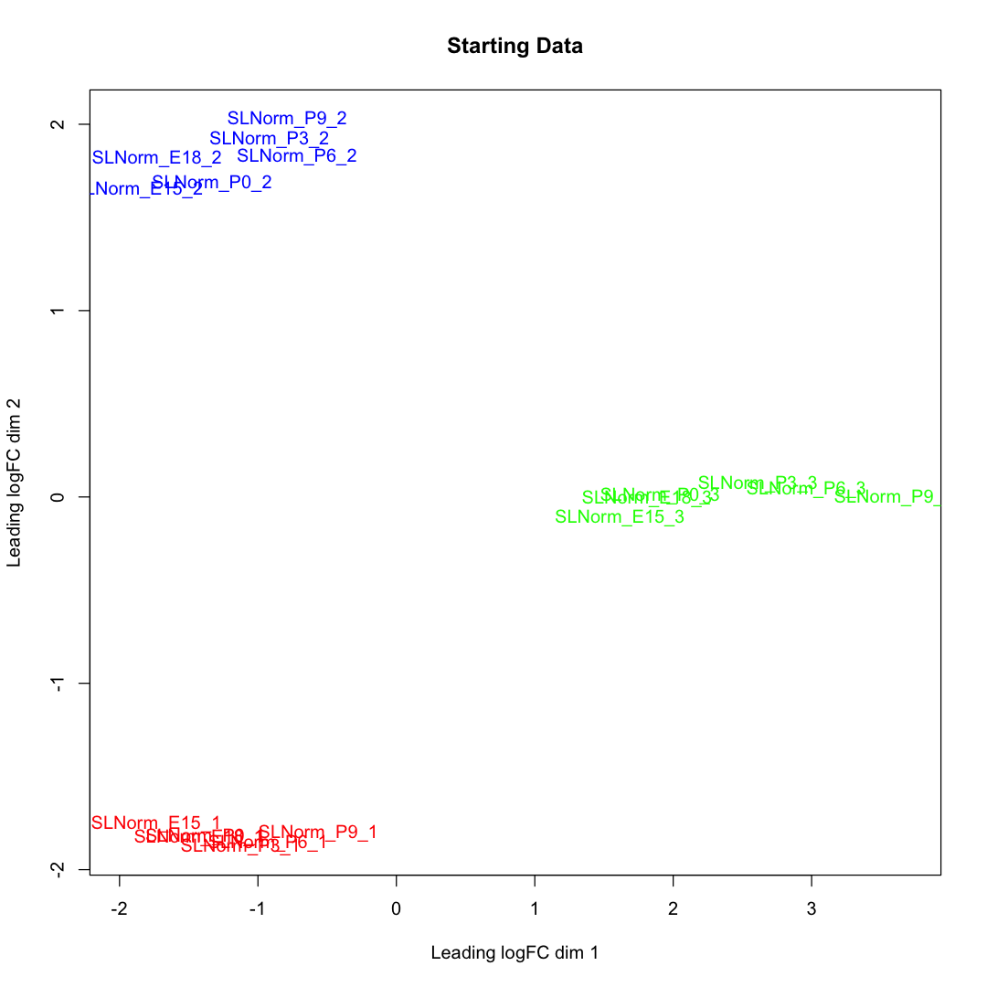
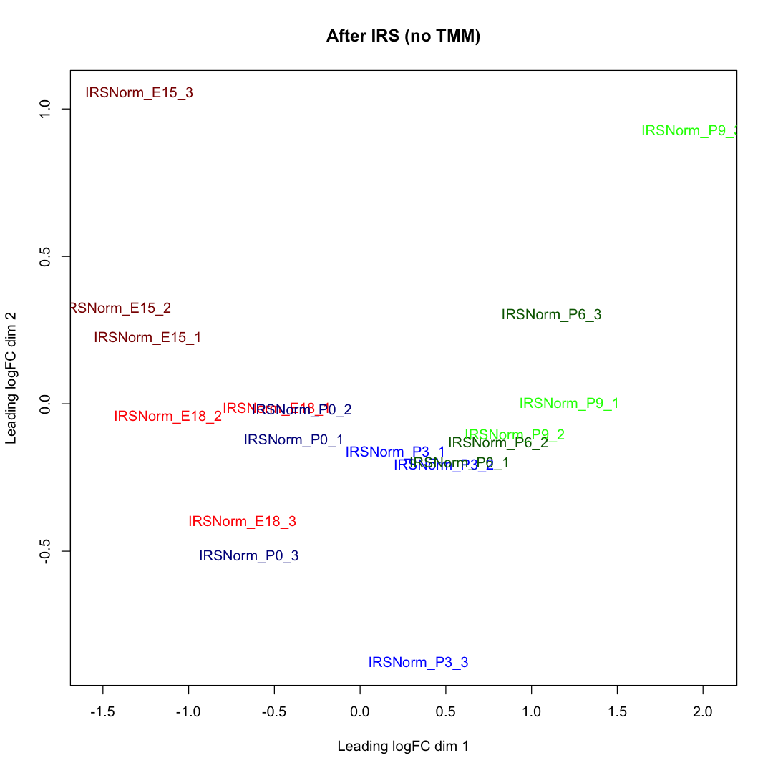
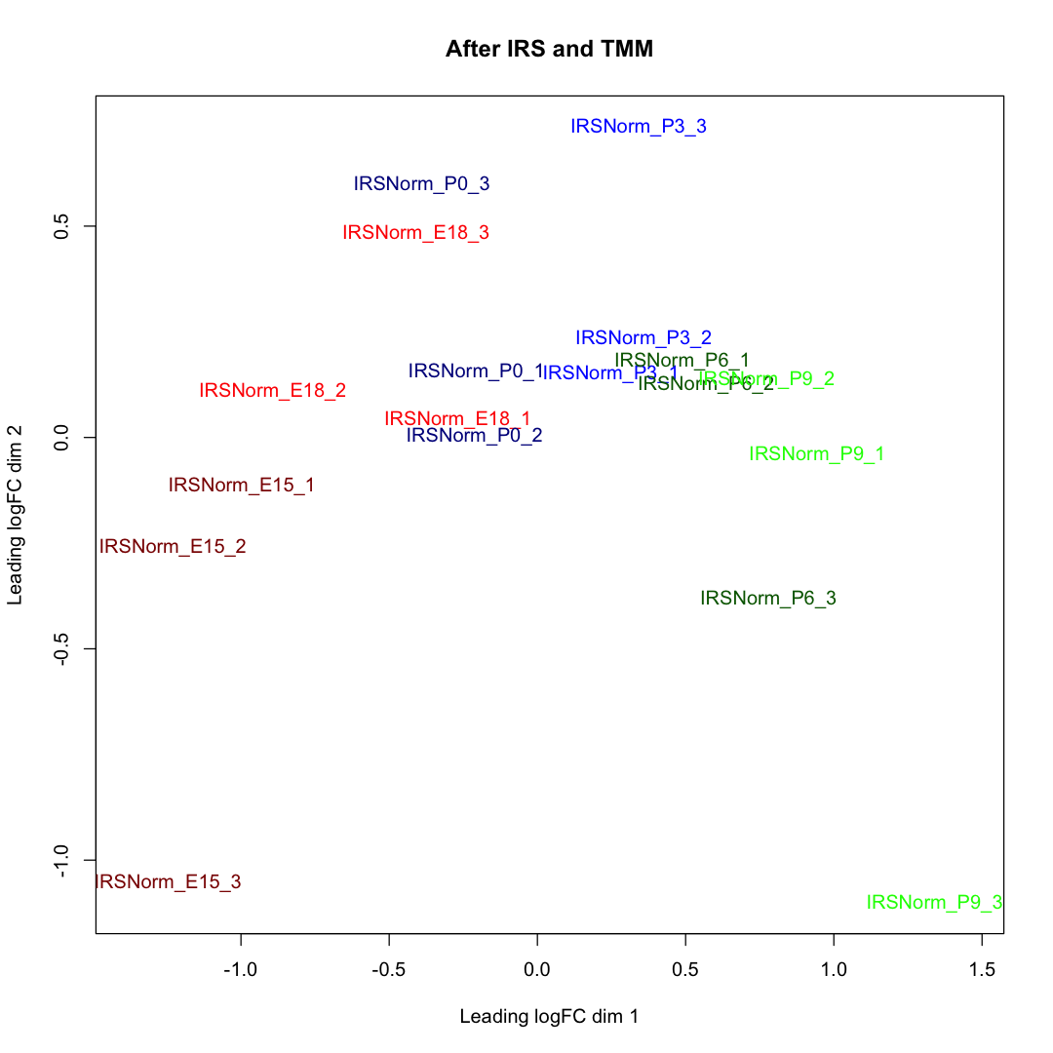
Plex batch-like effect obscures the biology
Plexes cluster together without IRS adjustment
Samples separate left-to-right by developmental age after IRS
Separation by age may be better after TMM

Slide 12
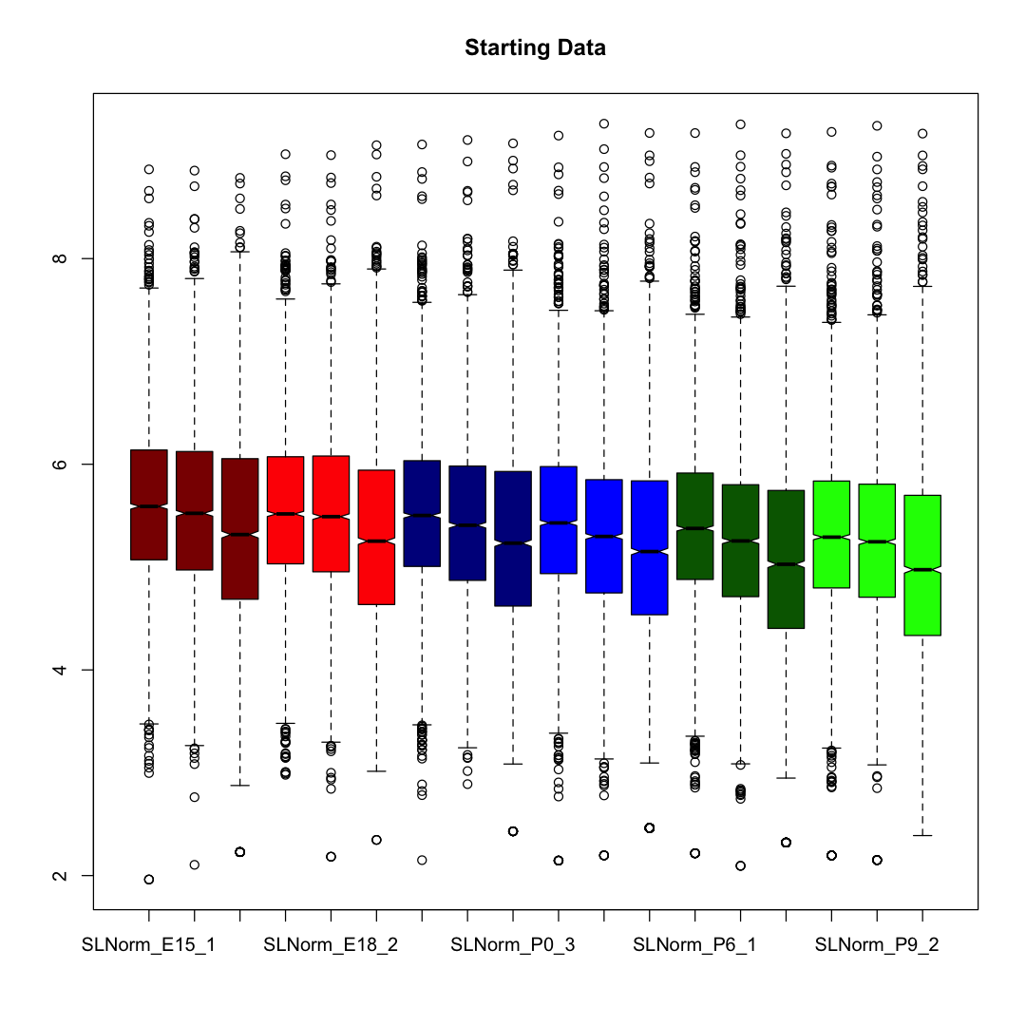
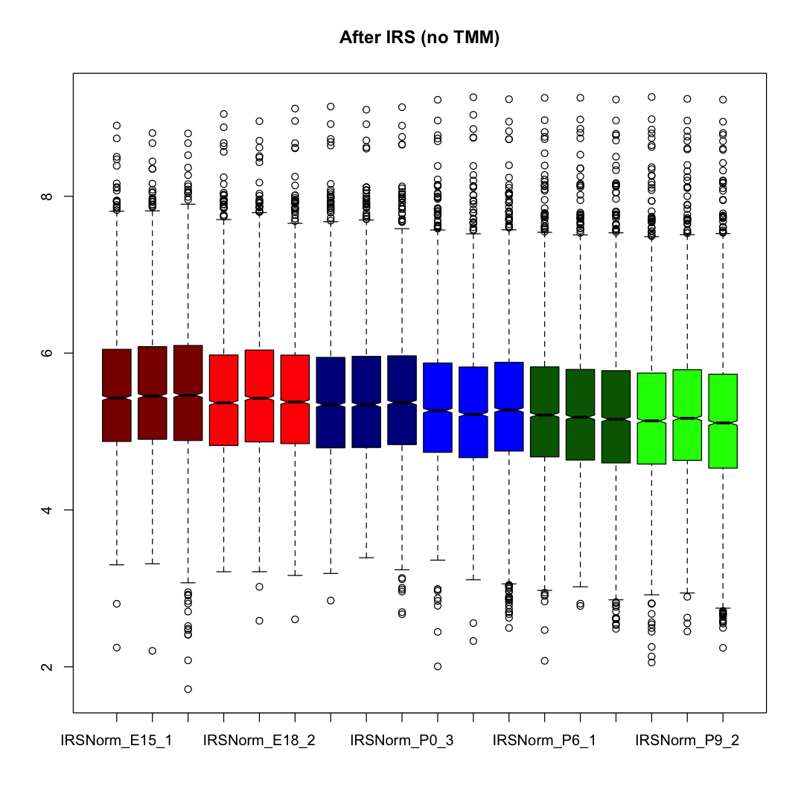
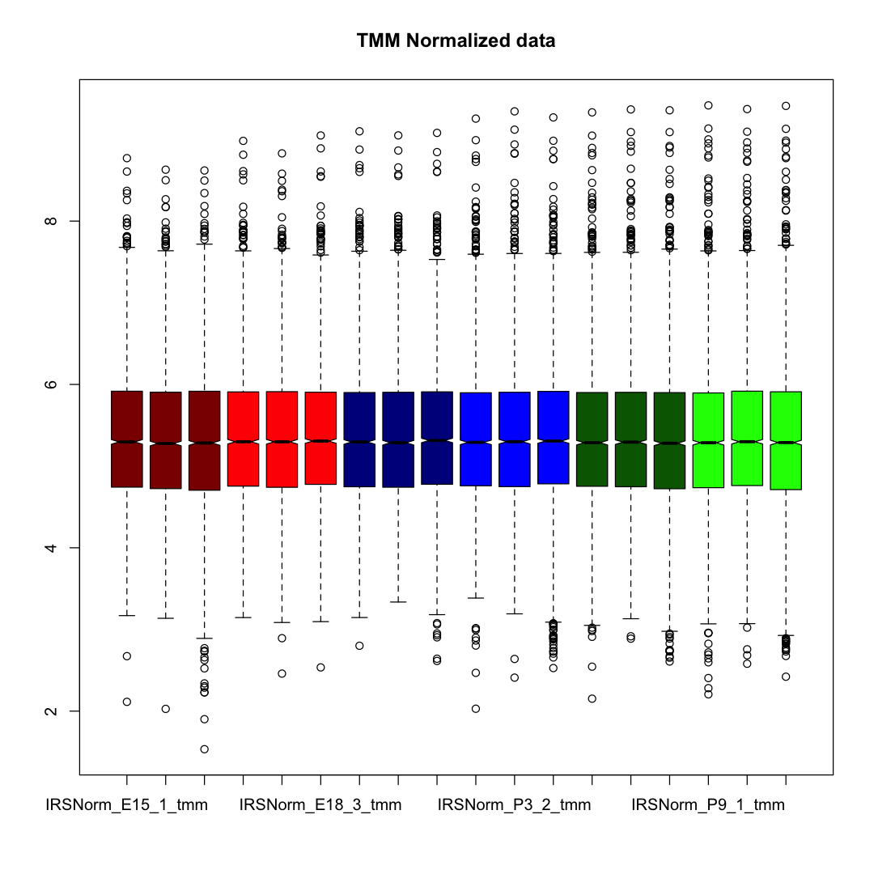
IRS only removes plex-to-plex variation
Left-to-right drop by plex at each age
Left-to-right drop by age for notches, boxes, and whiskers
Notches, boxes, and whiskers in horizontal alignment

Slide 13
QC checks most important part of data analyses
Need to understand data before statistical modeling
Outliers are not uncommon – complicated sample preps can fail
Normalization of data is critical – many normalization methods should not be used
Single normalization steps are often insufficient for these complicated data
Normalization directly affects the null hypothesis in modeling
TMT methods have high precision and small fold changes making proper normalization even more critical

Slide 14
Developing mouse lens
Epithelial cells (anterior lens surface monolayer) differentiate into mature fiber cells (also called the lens nucleus)
Lens has little or no protein turnover
Each age includes all previous protein
E.g., P3 proteome is P0 proteome plus protein synthesized from newborn to day 3
Mature fiber cells consist of over-expressed lens proteins
Crystallins, filament/structural proteins, membrane channels
Cells lack organelles, molecular machinery, enzymatic activity
Cortex (outer lens region) is the differentiation zone from epithelial cells to mature fiber cells

Slide 15
Lens growth affects lens proteome
Lens increases in size over the developmental ages
Lens size changes fraction of lens proteins that come from the surface (epithelial cells) versus the interior (cortex and nucleus)
Larger lenses will have relatively more mature fiber cell content
Surface area versus volume argument
Expected aging trends (per unit amount of total lens protein)
Proteins from epithelial cells will decrease in relative abundance
Proteins from mature fiber cells (like crystallins) will increase in relative abundance
Cortical proteins should fall in between these extremes

Slide 16
Geometric effect on relative abundances
Dark blue sphere (cross section) compared to light blue sphere:
Diameter increases by 1.26
Surface area increases by 1.59
Volume doubles
Epithelial cell fraction (area) decreases with increasing lens size (volume)
Early development protein (light blue) fraction decreases with increasing lens size

Slide 17
Data normalizations are very important
Non-biological variance can be large
Many bench steps introduce variability
Complicated measurement systems introduce variability
Technical variability can obscure biological variability
There are multiple normalizations done in all experiments
Protein and peptide assays imply molecular normalizations (equal amounts)
Normalization methods can reduce non-biological variability
There are many methods; only a few are appropriate
Some normalizations are very specific (IRS in multi-plex experiments)

Slide 18
Software normalizations in TMT experiments
Equal protein/peptide amounts of each sample are labeled
Implies total reporter ion signal per channel should be the same
Repeated analyses (LC and mass spec) of the same sample should give the same measured values
Implies common reference channels should have the same reporter ion intensities (the concept behind IRS)
Proteins with unchanged abundance between conditions should have very similar measured values
Concept behind most common normalization algorithms

Slide 19
Normalization affects statistical testing
Statistical testing is usually rejecting a null hypothesis
Null hypothesis is often proteins should have same relative abundances between groups
Many normalization methods make ”unchanged proteins” have the same relative abundances
The “unchanged proteins” are the null hypothesis
Different normalization methods make different proteins more similar and result in different null states

Slide 20
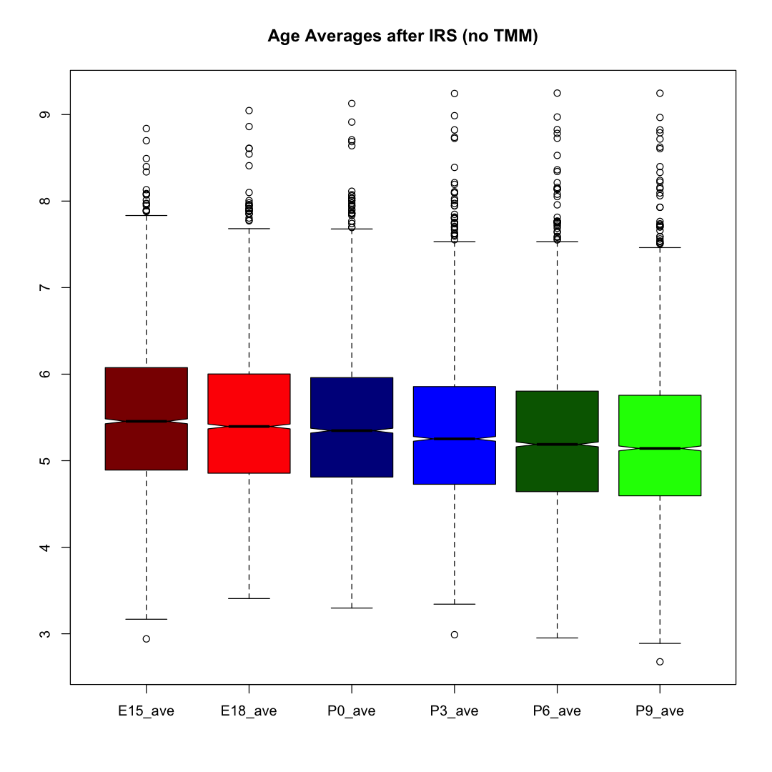
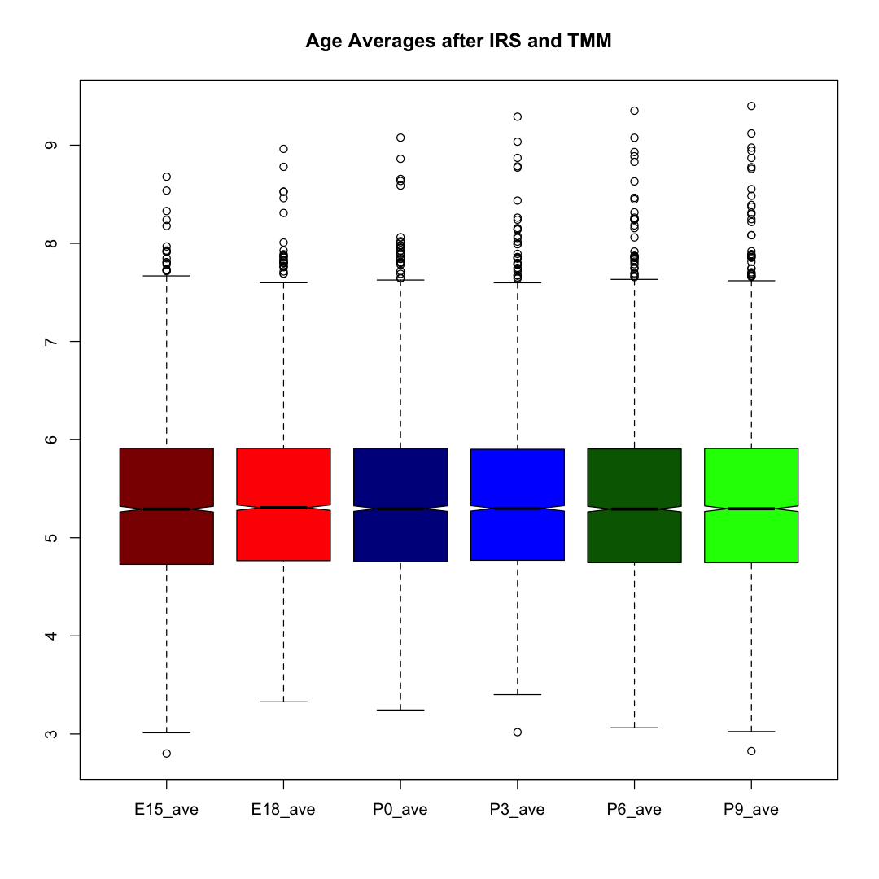
Normalization choice affects DE candidates
Intensity grand total matching
Median intensity matching

Slide 21
Normalization choice affects ANOVA or pairwise comparison results
DE Candidate Counts: | IRS Without TMM |  | IRS With TMM
Statistical Testing | Unchanged Proteins | DE Candidates | Unchanged Proteins | DE Candidates
One-way ANOVA | 1,024 | 3,226 | 2,373 | 1,877
Younger -vs- older pairwise comparison | 684 | 3,566 | 2,001 | 2,249
Direction of Abundance Change Counts: | IRS Without TMM |  | IRS With TMM
Data | Negative FC (Down) | Positive FC (Up) | Negative FC (Down) | Positive FC (Up)
Younger -vs- older pairwise comparison | 3,914 | 336 | 2,118 | 2,132

Slide 22
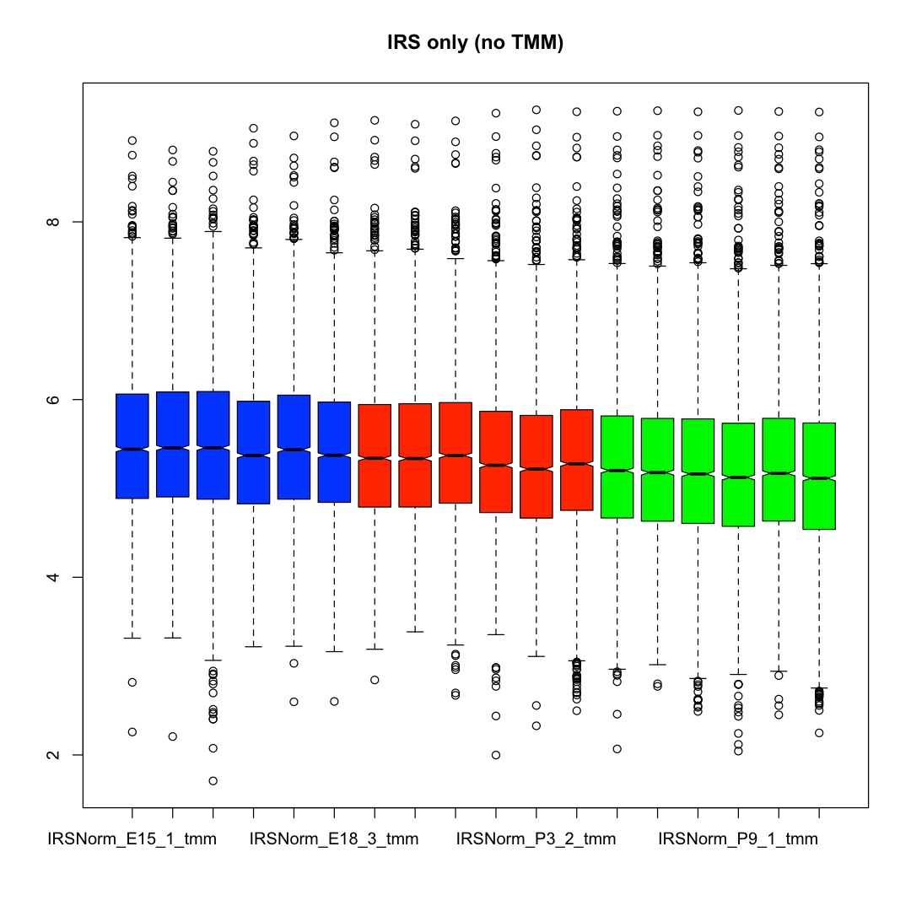
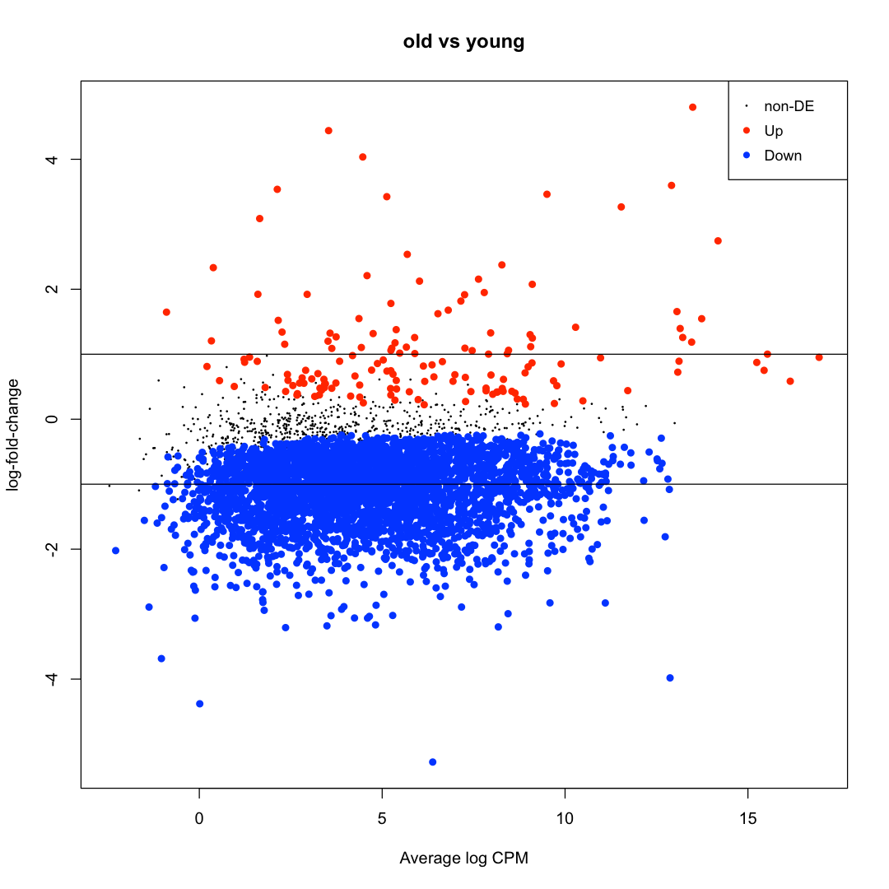
Intensity grand total matching (IRS only) First 6 samples (E15+E18) versus last 6 samples (P6+P9)
152 Up
684
3,414 Down
The 150+ “Up” proteins suggest mature fiber cell proteome is larger than prior work suggests

Slide 23
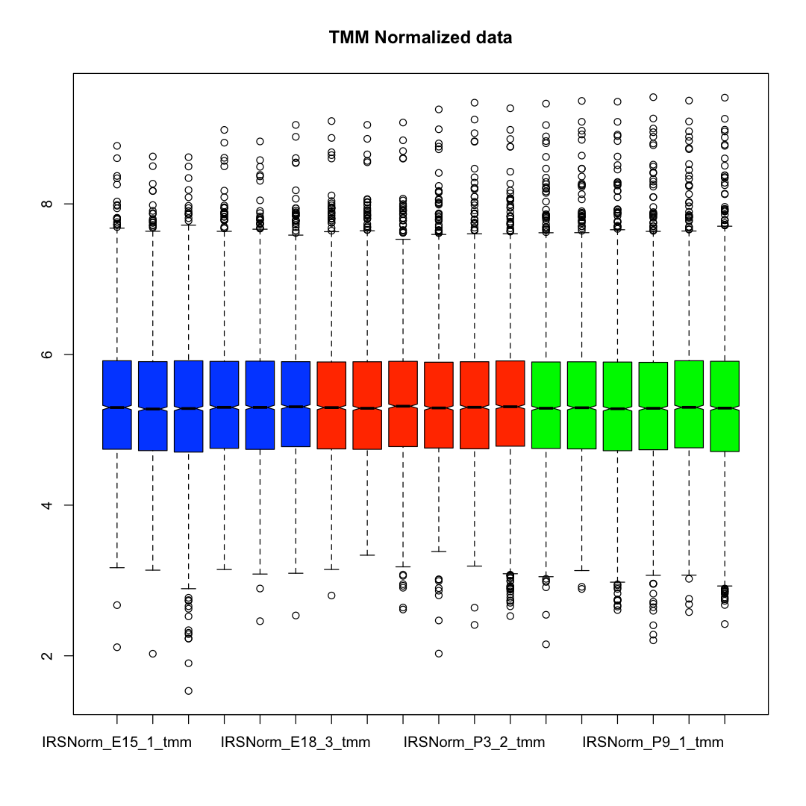
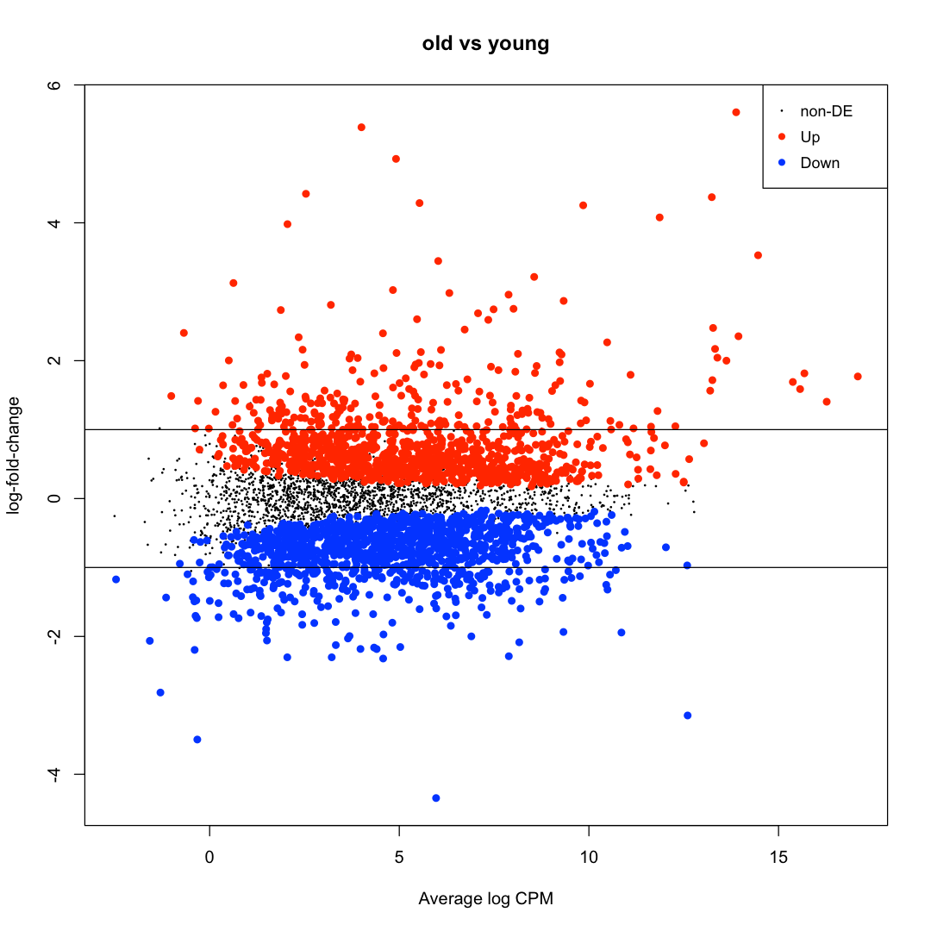
TMM normalization after IRS First 6 (E15+E18) versus last 6 (P6+P9)
1,081 Up
2,001
1,168 Down
TMM normalization categorizes developing lens proteins more equitably into 3 groups

Slide 24
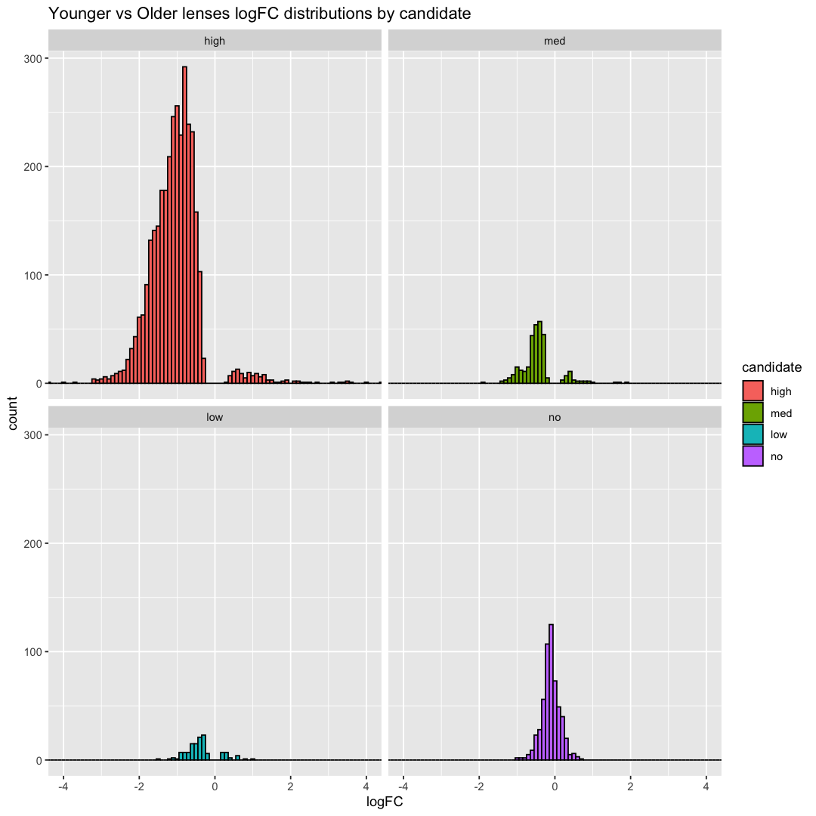
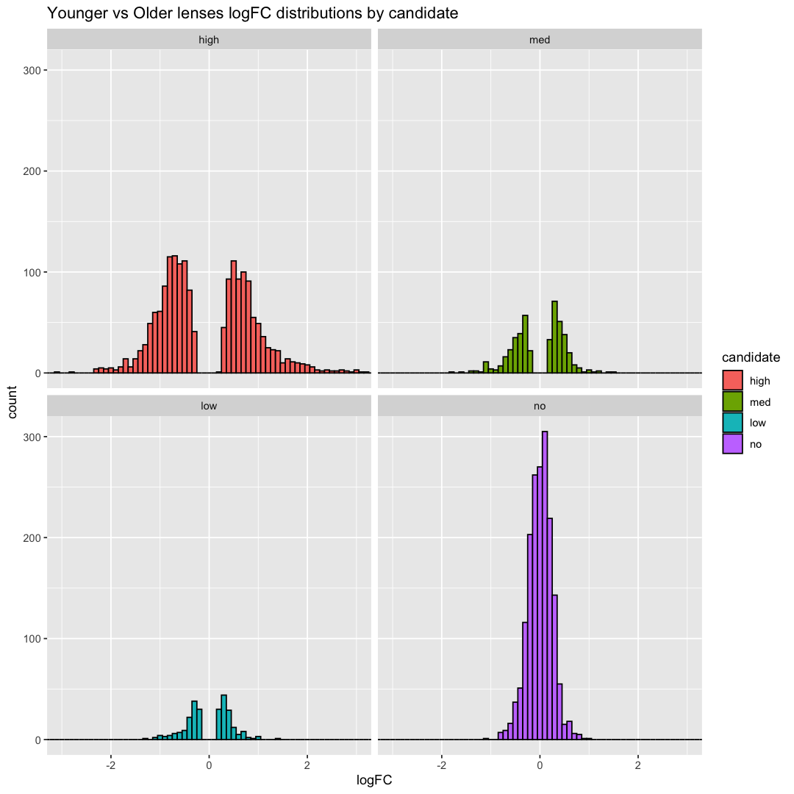
log2 fold-change distributions by significance cuts

Slide 25
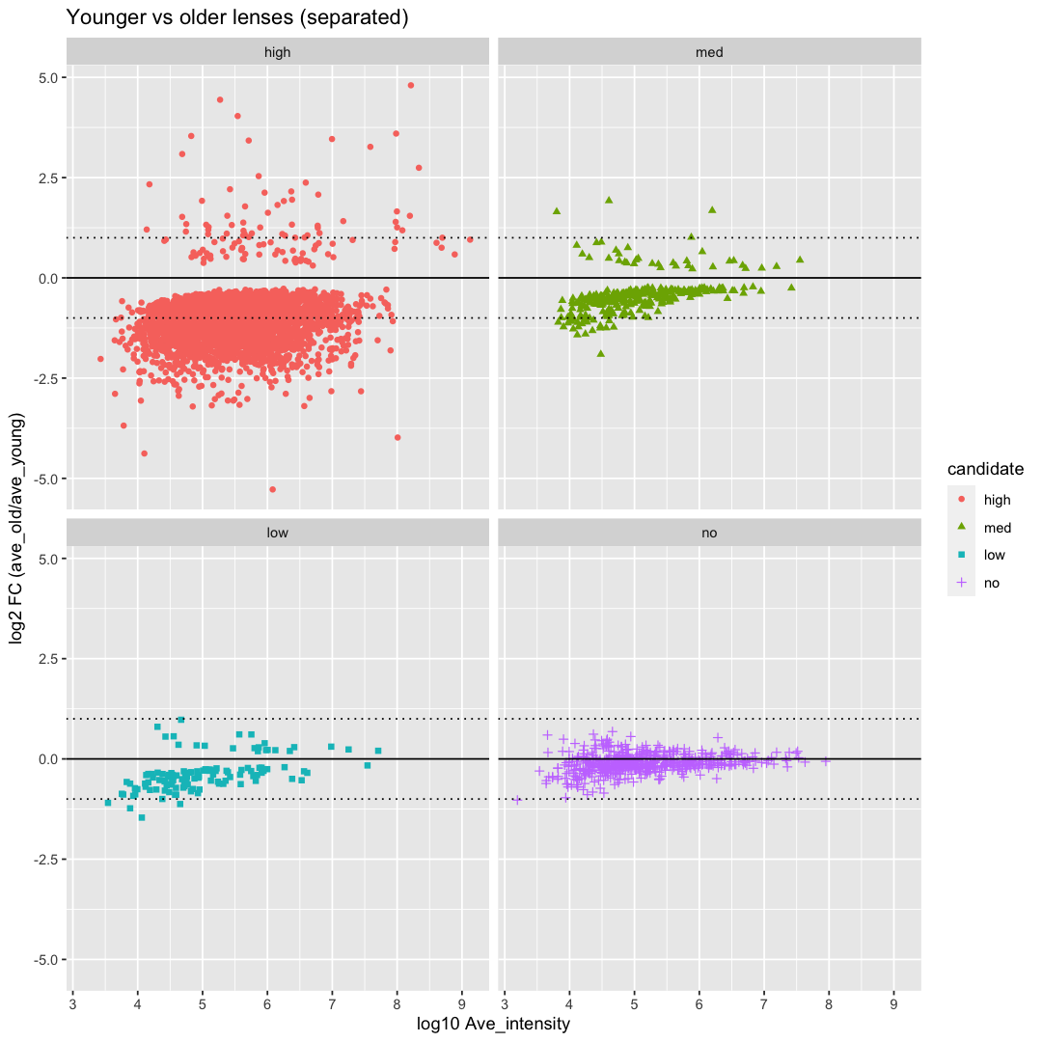
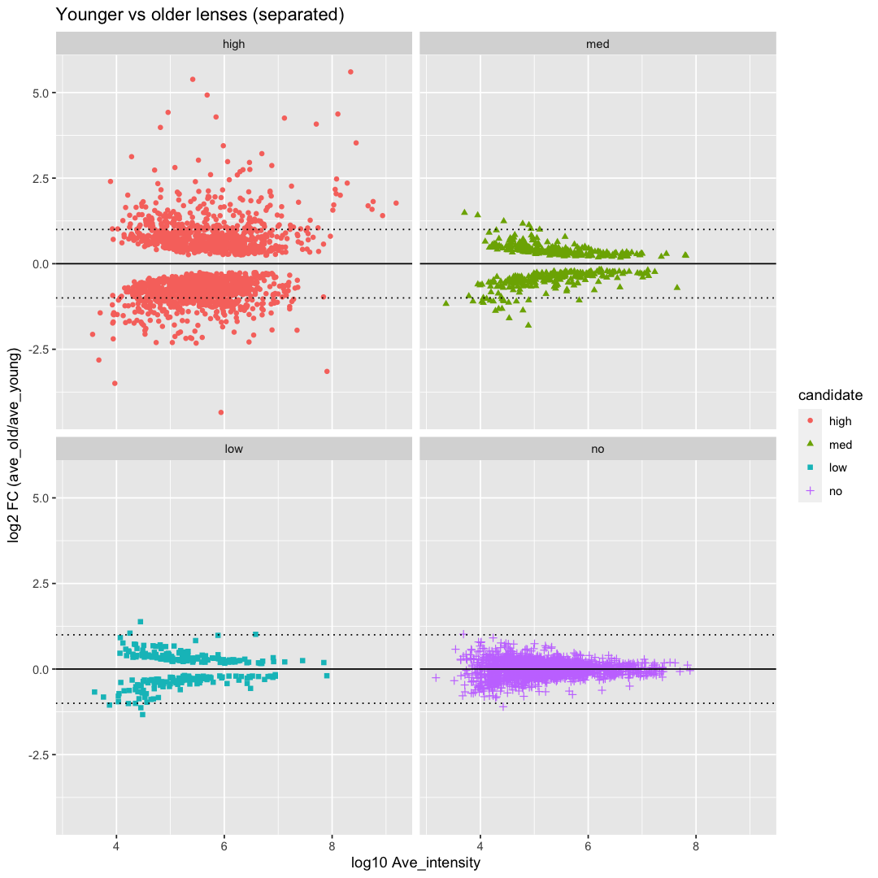
DE candidates by significance cuts
3,253
313
1,790
459
128
556
261
1,740

Slide 26
Proteome changes with age
Visualizing time course studies is challenging
What metric summarizes proteomes?
Clustering?
Heat maps?
Cumulative distribution functions?
What abundance change patterns classify proteins into groups?
Are large positive changes signatures for over-expression of lens proteins?
Do epithelial proteins have large negative changes?

Slide 27
Cumulative relative abundances show age grouping
Top 500 most intense proteins are ranked by decreasing abundance for each age
Cumulative total intensity computed
Cumulative abundance plotted as %
Ages separate into 3 groups:
E15
E18 and P0
P3, P6, and P9
P3, P6, P9
E18, P0
E15

Slide 28
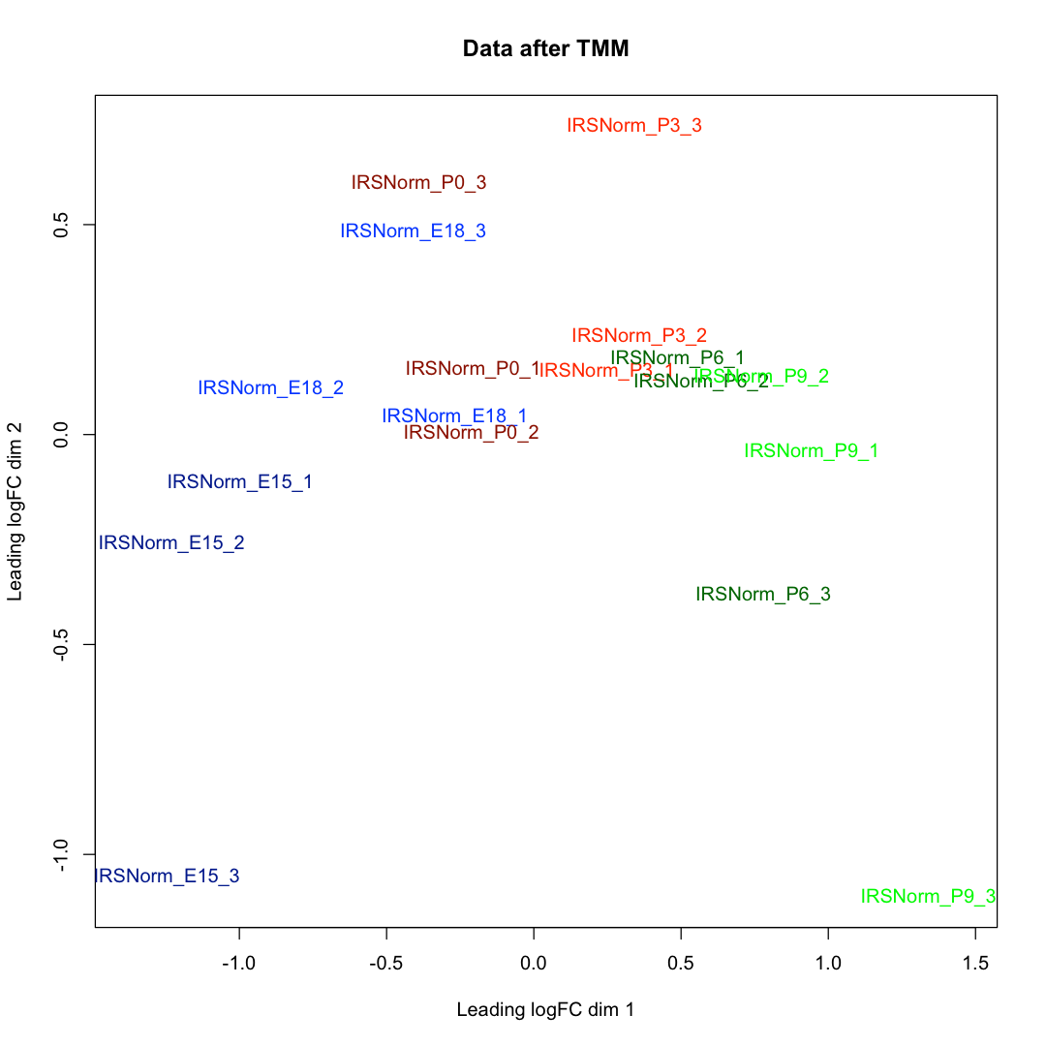
Age groupings also present in MDS plot
Top 500 proteins (largest standard deviations) are used
X-axis distance is more important
Dotted lines are group averages
Large gap between E15 and E18/P0 (545 candidates)
Also, large gap between P0 and older ages (84 candidates)
Candidate counts between successive ages reflect gap sizes
545
6
84
5
10
Candidates
E15
E18
P0
P3
P6
P9

Slide 29
Thoughts on interpreting the data
ANOVA may not be that helpful (too many candidates)
Younger versus older ages pairwise test results (significance and/or fold change)
Significant Up (fiber cells), not significant (flatter), significant down (epithelium)
Three age groups comparisons (early, mid, and later expression changes)
Slopes of normalized intensities are potentially useful
Time (x-axis) and abundance (y-axis) need normalizing to get normalized slopes
up [fiber cells and/or lens role], flatter [maybe cortex], and down [maybe epithelial cells]
Median-intensity-based-relative-abundance categories (lens has wide dynamic range )
10x median might be higher abundance, 1x-10x maybe interesting, less than median low abundance
Trends of related groups of proteins (crystallins, heat shock, ubiquitin/proteasome, etc.)
Functional enrichment comparisons between contrasting subsets
Top positive slopes versus most negative slopes; top “Up candidates” versus top “Down candidates”, etc.

Slide 30
Explore major lens proteins to learn patterns
Pick 20 well-known lens proteins (shown below)
Plot Intensities as a function of age
Plot relative intensities out of the 20 protein totals by age (like 2D-PAGE studies)
Plot intensity differences between successive ages (remove accumulated protein)
Normalize each protein versus age data to make abundance-independent scale
Category | Lens Protein
alpha crystallin | αA, αB
beta crystallin | βA1/A3, βA2, βA4, βB1, βB2, βB3
gamma crystallin | γA, γB, γC, γD, γE/F
structural | filensin, phakinin
membrane | MIP, Gja8
other | FABP

Slide 31
20 mouse lens protein exploration
Total crystallin abundance is nearly linear with age (after TMM)
Small adjustments (mostly P0) result in linear trend (the reference pattern for major lens proteins)

Slide 32
4 proteins have different pattern
αB
βB2
γS
FABP
alpha B, beta B2, gamma S, and FABP have increased expression at later ages

Slide 33
Abundances as fractions (%) of 20-protein total
αB
βB2
γS FABP

Slide 34
Lens has no protein turnover – compute differences
βB2
αB
γS

Slide 35
Normalized intensities are useful (scaled by protein median)
later development
later development
lens pattern
lens pattern
lens pattern
lens pattern
?
?

Slide 36
Shared peptides for gamma crystallins
Canonical FASTA files and extended parsimony protein grouping reduce total intensity loss from excluded shared peptides
Majority of proteins have no or few shared peptides after grouping
Certain protein families are exceptions
Gamma crystallins in lens have a complicated pattern of shared peptides
Crystallin | Fraction Unique | Crystallin | Fraction Unique
Gamma A | 79.1% | Gamma D | 4.8%
Gamma B | 46.5% | Gamma E/F | 23.7%
Gamma C | 26.3% | Gamma S | 100%

Slide 37
Shared peptide quantitative information can be fractionally “split”
PAW pipeline does this for spectral counting totals (Corrected SpC)
TMT channels are an extra dimension of quantitative data
Intensities have more dynamic range than spectral counts
Each channel has different shared and unique intensity totals
Logic for SpC splitting can be applied per channel using intensities
Manually done for the gamma crystallins at P0 age and for Set 1 plex

Slide 38
Total gamma intensities change after splitting
Gamma crystallin | Unique intensity total (default values) | Intensity totals with extra fractionally split shared peptides | Intensity increase factor
Gamma A | 428,918,909 | 514,459,509 | 1.20
Gamma B | 101,259,867 | 158,276,338 | 1.56
Gamma C | 82,691,628 | 220,943,948 | 2.67
Gamma D | 23,838,777 | 100,325,296 | 4.21
Gamma E/F | 109,564,209 | 335,372,413 | 3.06
This has implications for comparing relative abundances of different proteins, comparing to published studies, etc.

Slide 39
Comparison to Ueda 2002 paper (2D-PAGE)
Lens Protein | Ueda 2002 Relative % | TMT Default Relative % | TMT Relative % (w/ splitting)
Beta B1 | 10.3 | 18.9 | 16.6
Beta B2 | 0.2 | 0.5 | 0.4
Beta B3 | 9.9 | 11.2 | 9.9
Beta A1/A3 | 7.6 | 11.8 | 10.4
Beta A2 | 1.9 | 2.7 | 2.3
Beta A4 | 1.9 | 2.2 | 1.9
Alpha A + insert | 20.3 | 31.0 | 27.3
Alpha B | 4.6 | 3.0 | 2.6
Gamma A | 9.3 | 10.1 | 10.6
Gamma B/C | 4.8 | 4.4 | 7.6
Gamma D | 9.1 | 0.7 | 2.5
Gamma E/F | 19.1 | 2.5 | 6.7
Gamma S | 1.0 | 0.9 | 0.8
FABP | 0.1 | 0.3 | 0.3
αA
βB1
βA1/A3
γA
βB3
γB/C
γE/F
γS
βA2 βA4
αB
γD
βB2 FABP

Slide 40
Summary of developing mouse lens
Khan 2018 data is a good resource
Proteome depth is very good; third set ran less well
Better analysis and proper between plex normalization (IRS) helps
Different (post IRS) normalizations affect results and interpretation
Normalization choice should match interpretation goals
How normalization affects data is critical to understanding statistical testing and interpretation of results
Several techniques for expression pattern finding were outlined
ANOVA, age-grouped pairwise comparisons
Normalized age/intensity plots useful for exploring major lens proteins
Mature fiber cell proteome is richer than prior studies suggest

